Slide 1
React Basics
2021

Slide 2
Key concepts to learn in this training
React Basics
JSX and TSX
Props, state and hooks
Custom hooks and provider pattern

Slide 3
Part 1– Hello World
What is React?
What is ReactDOM
How do I create a simple React Component?

Slide 4
What does this code do?
See it
import React, { Component } from 'react'; import ReactDOM from 'react-dom'; export class HelloWorld extends React.Component { render() { return 'Hello World'; } } ReactDOM.render(React.createElement(HelloWorld, null), document.getElementById('root'));

Slide 5
The answer:
With React, we can use a render() method to set up a HTML element.
With ReactDOM we show that HTML in the DOM

Slide 6
Child-Components
export class Hello extends React.Component { render() { return 'Hello'; } } export class HelloWorld extends React.Component { render() { const hello = React.createElement(Hello); const space = ' '; const world = React.createElement('span', null, 'world') return React.createElement('div', null, [hello, space, world]); } }
See it

Slide 7
What is this second parameter? Don‘t tell me we can make this dynamic?
export class Greetings extends React.Component { render() { return 'Hello ' + this.props.what; } } ReactDOM.render( React.createElement(Greetings, { what: 'world' }), document.getElementById('root'));

Slide 8
What does createElement create?
createElement('span’, { name: “Zlatko”, age: 44 }, [“span”, “div”, Button])
createElement creates instances of React elements
Every React component (extending from React.Component class) has properties
We call these props

Slide 9
Component: Props and Children
Every React component (extending from React.Component class) has properties.
We call these props.
Every React component has nested react elements.
We call these children.
* - Well, Every component does have props and children, but they can also be empty/null.

Slide 10
Let’s try creating react elements with functions instead of class.
import { createElement } from 'React'; function Hi(props) { return createElement('span', null, ['Hi ', props.what]) }

Slide 11
Modernise it a bit to ES2015+…
const Hello = props => createElement('span', null, ['Hello ', props.what]);

Slide 12
...and one step closer to idiomatic React

Slide 13
What does the component retrn?
const Hello = ({ what }) => createElement('span', null, ['Hi ', what]);
Here

Slide 14
React Components do not return HTML Elements!
Nor do they create them.

Slide 15
Can this Component (or well, the function) return two <span> Elements?
A sidenote on ES6
const Hello = ({ what }) => { const span1 = createElement('span', null, ['Hi ', what]); const span2 = createElement('span', null, ['Hi again']); return ... hmm ... return span1, span2? // nope that's Golang return (span1, span2)? // nope, "undefined" return span3ContainingSpan1AndSpan2; }
Golang can, but React can’t
package main // Return Typ (int, int) gibt 2 ints zurück. func vals() (int, int) { return 3, 7 }

Slide 16
We can only ever return one root element from a React Component
That‘s not exactly true.
We can wrap them in a „React Fragment“.
But we mostly pretend it‘s just one.
Generally, we try to always return one top-level item - one component, one job.
const Hello = ({ what }) => { const span1 = createElement('span', null, ['Hi ', what]); const span2 = createElement('span', null, ['Hi again']); return createElement(React.Fragment, null, [span1, span2]); }

Slide 17
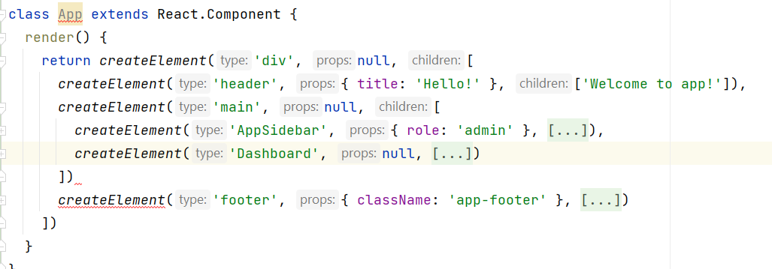
Anyway, big app

Slide 18
All the stuff so far is cool, but tiresome
Manually setting up elements with createElement is a bit of a boilerplate
Let‘s see what JSX can do for us regarding this.

Slide 19
Jsx Hello World
const Hello = ({ what }) => <span>Hello {what}</span>;

Slide 20
„What???“ – asks IntelliJ

Slide 21
Is this compatible to good old ES5 flavor of JavaScript?
function Hello({ what }) { return <span>Hello {what}</span>; }
Funktioniert wirklich

Slide 22
That‘s no JavaScript!

Slide 23
It’s JSX!

Slide 24
The full example
import React, { Component } from 'react'; import ReactDOM from 'react-dom'; const Hello = ({ what }) => <span>Hello {what}</span>; ReactDOM.render( <Hello what="world!"/>, document.getElementById('root'));
Another Stackblitz instance, just to make sure we aren't hitting any race conditions or something with the first one

Slide 25
Can I do some JavaScript „logic“ in this funny format?
const today = Date.now(); const Time = ({ time }) => <span>It is {time.toLocaleTimeString()} now.</span>; const Hello = ({ name, time }) => <div> Hello { name }. <Time time="today"/> </div>;
Another Stackblitz

Slide 26
Can I make a little loop?
const names = ['My name', 'Your name', 'Yours as well', 'Her name I don\'t know’,
'But that\'s fine', ‘Hi there, your name is known :)’];
const Names = () => (<ol> {names.map(name => <li key={name}>{name}</li>)} </ol>);
If I squint a little, this really looks a bit like JavaScript?

Slide 27
Can‘t we not make this whole thing a little prettier?
const styles = { padding: '0.4rem', 'list-style-type': 'ethiopic-halehame', 'fontWeight': 'bolder', }; const Names = () => ( <ol styles={styles}> {names.map(name => <li key={name}>{name}</li>)} </ol> );
Pretty

Slide 28
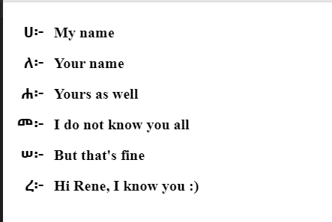
(Just in case my Chrome didn‘t work that time)

Slide 29
Can‘t we write a regular CSS?
ul { display: flex; margin: -5px; } li { flex: 1; margin: 5px; padding: 4px; list-style-type: georgian; }
import './styles.css';
CSS Datei JS Datei
Flexbox still working

Slide 30
Anyway… how do we set up a React Component?

Slide 31
1. extend React.Component class and return Elements out of „render()"
class ClassyComponent extends React.Component { render() { return 'Something'; } }

Slide 32
2. Return some result from "createElement"
const WeirdlyLookingComponent = createElement('span', null, 'Something else');

Slide 33
3. Use a function and return a JSX element
const SimplestComponent = () => <span>I am jsx</span>;

Slide 34
Which variant did you find the simplest to understand?

Slide 35
Class and function components
We can use class- or function components
By using function components, we write less code and less Boilerplate, but they are more „frontend-y“
Class components may be simpler to understand for a backend engineer

Slide 36
In any case, we want to keep our components small, doing one job and returning one elements

Slide 37
And the last thing.

Slide 38
How do I add a React Component to the DOM (HTML Document)?

Slide 39
ReactDOM
ReactDOM.render(component, domContainer);

Slide 40
Practice
Set up a simple Todo Component
It should take two properties: Title and Description
They should be set up in an <h2> and in a <p>
Another assignment
Set up another component, <Todos>
Have it hold three individual Todo component instances.
Add two such Todo-Lists in the app component
Start at StackBlitz
https://stackblitz.com/fork/react

Slide 41
My questions (again)
What is React?
What is ReactDOM?

Slide 42
Your questions?

Slide 43
Part 2 - React and JSX

Slide 44
Goal
Understand how to use React with JSX
Use Types from TypeScript
Set up Tsx Components

Slide 45
So this is JavaScript ...
const comp = createElement('span', null, 'I am text');

Slide 46
…and this is JSX
const comp = <span>I am also text</span>;

Slide 47
Now this is TypeScript ...
const comp = createElement('span', null, 'I am text');

Slide 48
Then what is TSX?

Slide 49
Enterprise <strike>FizzBuzz</strike> React
import React, { Component } from 'react'; import { render } from 'react-dom'; interface HelloProps { what: string; } class Hello extends Component<HelloProps> { render() { return <div>Hello {this.props.what}</div>; } } render(<Hello what="world"/>, document.getElementById('root'));
Hello Stackblitz, my old friends

Slide 50
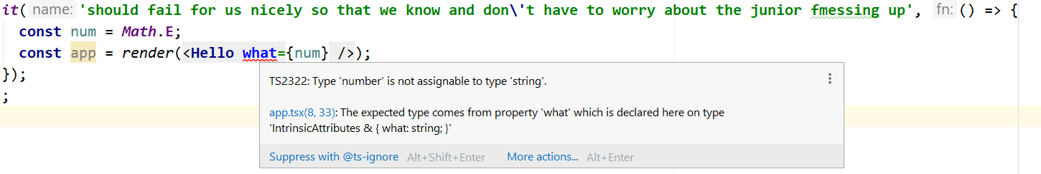
Why Enterprise?
Because this test fails and tells us that we can‘t be using numbers and strings together.
const num = Math.E; const app = render(<Hello what={num} />);
No juniors were hurt while creating this screengrab.
A lot of us here are React Juniors :)

Slide 51
Questions so far?

Slide 52
So how can we set up React with TypeScript?
Manually
`create-react-app` - Standard, simple, uncomplicated
`nx-workspace` - a little more complicated, but with a lot more things to help us out of the box
`git clone one-of-the-million-repos-on-github`

Slide 53
CRA - your neighbourhood hacker's starter
CRA:
from React team
has decent starter templates
includes `start`, `test`, `build` and `eject` scripts and setup by default
fire it up at app start and then you don't use it any more
has many custom templates with many more things configured
uses webpack to bundle all the things, with `eject` we can customize it
craco lets us play with that config without manually maintaining

Slide 54
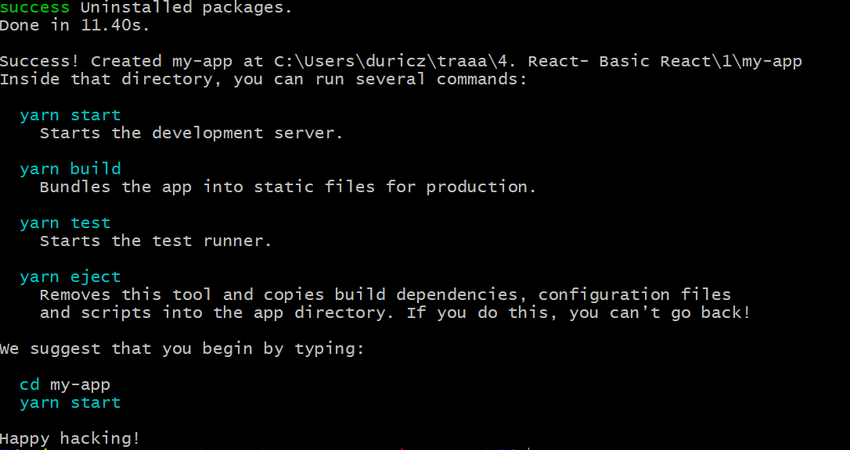
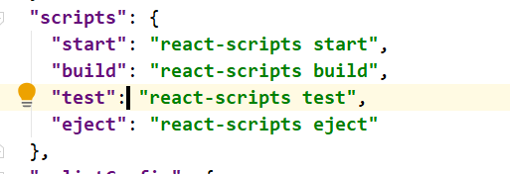
create-react-app
npx create-react-app my-app --template typescript

Slide 55
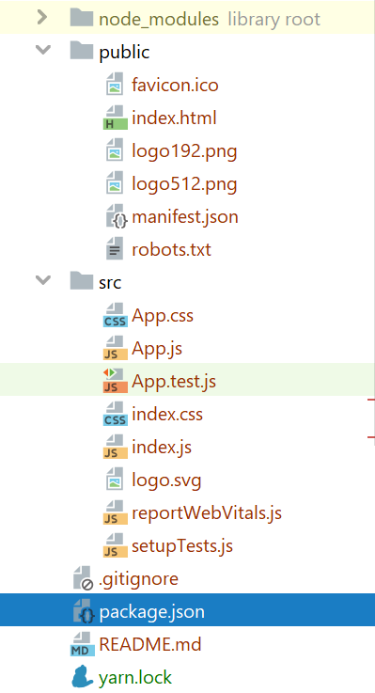
What do we get with it?

Slide 56
nx – “Enterprise” Setup
part of nx devtools
has standard things wired up
wires up advanced linting setup, e2e tests, dependency graphs
standardizes application structure and setup
provides ongoing support
has everything an enterprise app developer would ask for
* - if we‘re being modest.

Slide 57
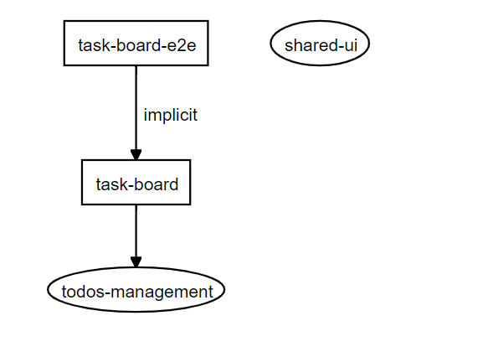
Nx – more then just Setup
npx create-nx-workspace my-shiny-app --preset=react
nx generate application idh
nx generate application mpr
nx generate library shared-ui
nx generate library mpr-ui
nx generate component todos --project todos-management
nx lint shared-ui
nx affected:test shared-ui
nx dep-graph

Slide 58
One of the million boilerplates on GitHub
E.g. customer-specific setup, or boilerplate project
Specific needs for build minifiers, or media converters or some such
Built for specific purposes
E.g. Native React setups
Brings the joy of maintaining the whole stack ourselves

Slide 59
StackBlitz
No Setup
No build step
No deployment step
So obviously we’ll be using it a lot in our training.

Slide 60
Questions?

Slide 61
Practice time
Fork a react-ts Stackblitz in a new App
Create a user-card.tsx component, that takes username, email and an address through props.
Set up a user-list.tsx and that takes a whole list of such users as a prop, and for each element in the list, sets up a UserCard.
In the App Component, the import a list of users (e.g. from here), set up the app title („User Management“ or whatever), and give the list of users to the UserList.

Slide 62
That’s all for this block!

